Slide 1
Introduction to the AgLU Data System
Page Kyle
April 26, 2012

Slide 2
Outline
Overview of data sources
Overview of assumptions and mappings
Overview of processing methods
Overview of file structure
Running the system
Modifying the data, assumptions, and mappings
Modifying the code

Slide 3
Primary Data Sources
GIS data
HYDE: Cropland, pasture, and built-up land from 1700 to 2005
SAGE: “Natural vegetation” (i.e. absent human influences)
IGBP soils data – not currently used
Ramankutty fertilizer data – only processed for comparison
Agricultural data
FAO: national statistics
Crop production, harvested area, disposition, and prices
Animal production, trade, disposition, and prices
Roundwood production, trade, and prices
USDA: costs of agricultural production of 7 crops by USA subregion
GTAP: agricultural production and harvested area by country and AEZ
IMAGE: animal production characteristics by 24 regions
System type (mixed/landless, or pastoral)
Feed types used (grass, fodder crops, feed crops, other)
Feed input-output coefficients

Slide 4
Mappings and Assumptions
Mappings: categorical classifications assigned to input data. Examples include:
Crops to GCAM commodities
Countries to GCAM regions
Land use types in GIS databases to GCAM land types
Assumptions – examples:
Exogenous numerical assumptions
Specification of structure of agricultural and land use sectors in GCAM
Includes data from GCAM that is used in the processing (e.g. population and GDP, base-year biofuel production)
countries | GCAM_region_ID | GCAM_region_name
Afghanistan | 11 | Southeast Asia
Albania | 12 | Eastern Europe
Algeria | 9 | Africa
American Samoa | 11 | Southeast Asia

Slide 5
Methods: Agricultural Sector
Inputs to animal production by region
Animal production by region
Roundwood production by region
IMAGE
FAO
Crop yield, production, and harvested area by region
Crop yield, production, and harvested area by AEZ
HYDE
GTAP
Land cover by country, land type and AEZ
SAGE
Houghton, others
Carbon density and mature age by land type and AEZ

Slide 6
Methods: Agricultural good balances
1990 is an average of 1988-1992, and 2005 is an average of 2003-2007
Modeled flows include
Production (FAO PRODSTAT)
Net Exports (FAO Commodity Balances)
Domestic supply (production minus net exports)
Feed (IMAGE, FAO Commodity Balances, FAO PRODSTAT)
Food (FAO Commodity Balances)
Biofuels (from GCAM energy system)
Other Uses (residual of domestic supply minus tracked uses)
Includes FAO Commodity Balances’ stock variation, processing, seed, and other util
GCAM_region_ID | GCAM_commodity | Year | Prod_Mt | NetExp_Mt | Supply_Mt | Food_Mt | Feed_Mt | Biofuels_Mt | OtherUses_Mt
1 | Corn | 2005 | 291.71 | 50.47 | 241.24 | 4.54 | 140.83 | 36.39 | 59.49
2 | Corn | 2005 | 9.96 | -2.20 | 12.16 | 0.68 | 9.17 | 0.00 | 2.30
3 | Corn | 2005 | 41.48 | -7.95 | 49.43 | 4.36 | 30.93 | 0.00 | 14.15
4 | Corn | 2005 | 0.25 | -16.75 | 17.00 | 1.83 | 9.59 | 0.00 | 5.58
5 | Corn | 2005 | 0.68 | -0.03 | 0.71 | 0.12 | 0.21 | 0.00 | 0.38
6 | Corn | 2005 | 13.78 | 0.94 | 12.84 | 1.52 | 5.76 | 0.00 | 5.56
7 | Corn | 2005 | 143.77 | 1.81 | 141.96 | 11.21 | 60.53 | 0.00 | 70.22

Slide 7
Methods: Reconciliation between HYDE cropland and FAO/GTAP-based harvested area
FAO fallow land portion (region)
Other Arable Land by AEZ
HYDE cropland (region, AEZ)
HA:CL<1
Production, economic yield, and cropland by crop type and AEZ
Crop yield, production, and harvested area by region
Feasibility rules
HA:CL>2.5
Reduction in unmanaged land cover (Grassland, Shrubland, Unmgd Forest, Unmgd Pasture)

Slide 8
Methods: Managed Pasture (disaggregated from HYDE pasture)
Inputs to animal production by region
Grass & hay inputs to animal production
Pasture grass consumption by region
Pasture grass consumption by AEZ
Crop yield, production, and harvested area by region
Hay production by region
Pasture biomass production by AEZ
Managed pasture land cover by AEZ
GTAP: Hay yields by AEZ

Slide 9
Methods: Managed Forest (disaggregated from SAGE/HYDE forest)
Carbon density and mature age by land type and AEZ
Forest biomass production by AEZ
Roundwood production by AEZ
Roundwood production by region
Managed forest land cover by AEZ

Slide 10
Methods: Land Cover
FAO/GTAP harvested area, feasibility rules
Cropland by crop
HYDE cropland
OtherArableLand
FAO roundwood, forest biomass production
Managed forest
SAGE forest
Unmanaged forest
Cropland expansion
SAGE grassland
Grassland
SAGE shrubland
Shrubland
Unmanaged pasture
HYDE pasture
Grass yields, grass consumption
Managed pasture
SAGE tundra
Tundra
SAGE rock/ice/desert
RockIceDesert

Slide 11
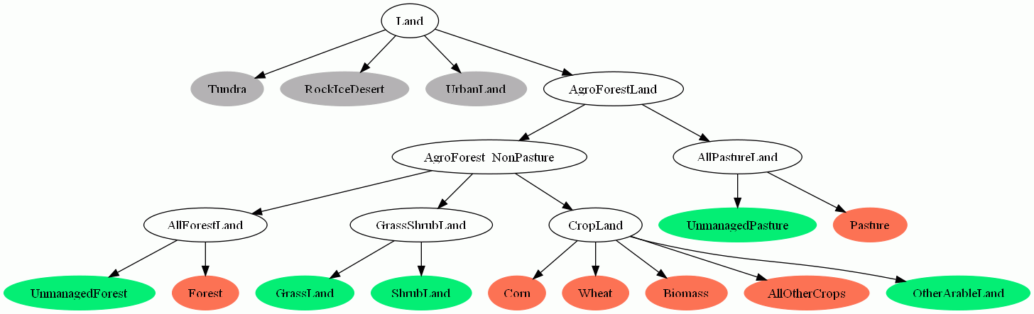
Methods: Mapping from Land Use Types to GCAM land nesting structure
White = Land nesting node
Gray = Exogenous land use type
Green = Unmanaged land use type
Green = Managed land use type

Slide 12
Outline: the data system
Overview of data sources
Overview of assumptions and mappings
Overview of processing methods
Overview of file structure
Running the system
Modifying the data, assumptions, and mappings
Modifying the code

Slide 13
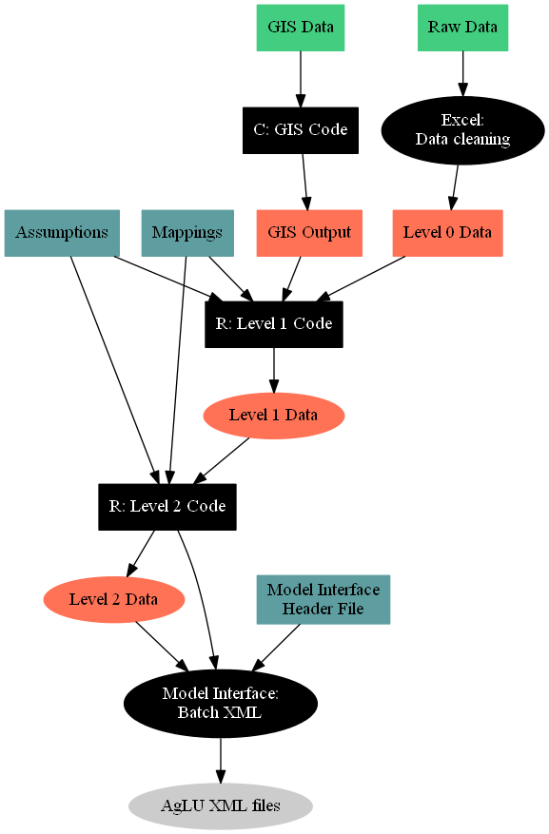
Box = committed to system; Oval = not committed
Green at top = raw data, from other sources
Black = scripted step
Red = data output
Turquoise = User-defined assumptions and mappings
Gray = final XML files for model input

Slide 14
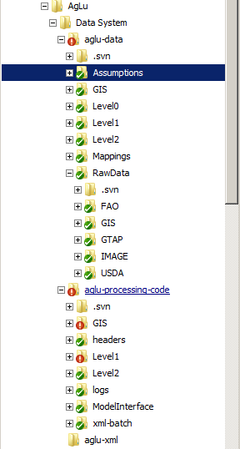
File Structure
Two “levels” of data processing (and output)
Level1: From primary data sources to intermediate tables
Level2: From intermediate tables to CSV tables formatted to be converted into XML, and
Level2 code builds model interface batch XML files
Model interface runs batch XML files to build the final model input XML files

Slide 15
Notations used in the data system
A list of about 140 strings and their definitions is available on the shared drive:
\IA Modeling Files\AgLU\AgLU Data System\Documentation\Data_System_Strings.xlsx
These strings are used throughout the system, and can be used to define any object or code file found in the data system
Note that only abbreviated strings are found in this file; un-abbreviated text needing no further clarification is not included (e.g. “cost”, “base_year”)
string | description
.melt | refers to a molten data frame (all data under a single column)
A | indicates an assumption
addl | additional
acr | acre
adj | adjusted from original data table of the same name
adv | advanced scenario
AEEI | autonomous energy efficiency improvement
AEZ | by AEZ (agro-ecological zone)
ag | agricultural product
agg | aggregated from original categories
AgProdChange | agricultural productivity change, as annual improvement rate
ALL | full mass balance table: production, net exports, supply, and all tracked dispositions
an | animal product
arid | arid (refers to arid AEZs)
avg | average

Slide 16
Running: Initial preparations (Windows)
Download the following programs if not installed
R
Install the ggplot2 library (and dependencies) from the command prompt (i.e. not the GUI)
install.packages( “ggplot2”)
Option 1: Windows: Gnuwin 32
Option 1: Windows: cygwin
Check out the data system from the repository
https://128.8.246.24/ag-data-svn/trunk/
https://128.8.246.24/ag-processing-svn/trunk/
Download supplementary Windows files from the shared drive
Z:\IA Modeling Files\AgLU\AgLU Data System\Additional Windows files
Option 2: \IA Modeling Files\AgLU\AgLU Data 2012\needed-exes

Slide 17
Running: Initial preparations (Mac)
Download the following programs if not installed
R
Install the ggplot2 library (and dependencies)
install.packages( “ggplot2”)
Check out the data system from the repository
https://128.8.246.24/ag-data-svn/trunk/
https://128.8.246.24/ag-processing-svn/trunk/
Run aglu-processing-code\Makefile to compile the GIS code and Model Interface

Slide 18
Running with the makefile (Windows)
In aglu-data, open up (“edit”) the run-make.bat file
Change the directories in the first line to the appropriate paths on the user’s computer
R (R\bin\x64)
Java\jre6\bin
Option 1: Point to cygwin\bin and Gnuwin32\bin
Option 2: Point to needed-exes folder
To run the system: SET CMD=all. Double-click the run-make.bat file.
To wipe the output: SET CMD=clean. Double-click the run-make.bat file.
Note that the log files are treated as the output; the Level1 and Level2 data files are not wiped in this step

Slide 19
Running with the makefile (Mac)
From a command prompt, run the makefile in the aglu-data folder

Slide 20
Troubleshooting the make file
This capability is too new to really have a troubleshooting section.
If you’ve made changes to the input data, ask Page
If you haven’t made changes to the input data, ask Pralit or Robert.
If the path name to R is incorrect:
process_begin: CreateProcess(NULL, R CMD BATCH ../aglu-processing-code/Level1/L 136_bio_prodchange_scenarios.R, ...) failed.
make (e=2): The system cannot find the file specified.
make: *** [../aglu-processing-code/logs/L136_bio_prodchange_scenarios.R.log] Error 2

Slide 21
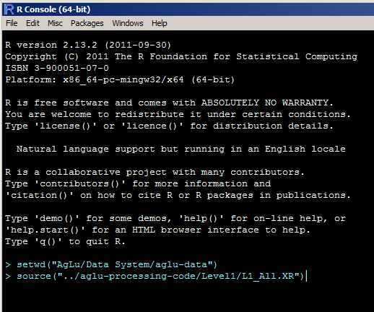




Running the R code by hand (without a makefile)
Note that GIS files aren’t set up to be run piece-by-piece
Set the working directory to aglu-data using the setwd() function (or Change Dir in the File menu)
Run the Level1 code using the source() function (or using Source R Code from the File menu)
Aglu-data\Level1\L1_All.XR will execute all scripts in the Level1 code folder
Run the Level2 code (Level2\L2_All.XR)
Can also paste in code line-by-line; all code files can be run independently as long as the dependencies exist, but lines within code files depend on previous lines

Slide 22
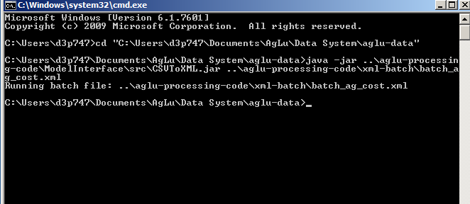
Building the final XML by hand
Need to run all files in the aglu-processing-code/xml-batch folder
The file paths are indicated as if the model interface is in the aglu-data (or equal level) folder
Option 1 (recommended; see below): Run the model interface from a command prompt in the aglu-data folder
Option 2: Copy a second model interface (GUI) to the data system (at the same level as aglu-data and aglu-processing-code)

Slide 23
Troubleshooting the R code
The R segments (Level1, Level2)
If it fails at the first line: check to make sure the working directory is correct. getwd()
If it fails at L120: the aglu-data/GIS folder doesn’t contain GIS output (run the scripts or download the output from the shared drive)
Any errors can be traced back to their source reasonably easily by looking at the warning messages in R
Check the log of the code file that failed
Read the code file that failed line-by-line into R
Find the object that caused the problem, and print its first few rows—head()—looking for any abnormalities (e.g. missing values). Look at all steps that modified the object.
The Model Interface segment
Make sure file path names in the XML batch files are correct (adjust the location of the model Interface as needed)

Slide 24
Running the XML in the model
Note that the file names are a bit different, so the configuration file will need to be updated
\IA Modeling Files\AgLU\AgLU Data 2012\configuration_ag.exe
To run with non-CO2’s, new files should be created with the changed AEZ names
The name change is that single-digit AEZ numbers are now prefaced with a “0” (e.g. AEZ01, AEZ02…AEZ18)
To rebuild XML files using the model interface, change both the XLS workbooks/CSVs and the header file
In just the XML, replace all AEZ1 with AEZ01, and so on
Use a quotation mark (e.g. from AEZ1” to AEZ01”) to avoid changing the double-digit AEZs

Slide 25
Differences with the existing core model
Documentation of all differences can be found at:
Z:\IA Modeling Files\AgLU\AgLU Data 2012\Documentation
The aglu data system has a complete fertilizer representation (documented in the same folder)
Regardless of whether the fertilizer input files are used, the base-year output replicates the core model, as does the future output with a few documented exceptions
The chart to the right is purpose-grown bioenergy; this showed the greatest differences of any crop

Slide 26
Making modifications to the input data
Raw Data and Level0 Data are replaceable (e.g. as new data becomes available, or if more years are desired)
Users have to remove all apostrophes, quotation marks, accents, and ensure that the format conforms with what R is expecting
Assumptions: Many user-set parameters are found in
aglu-data/Assumptions/A_aglu_data.R
Most parameters can be changed without further changes
Changing model time periods is somewhat more complex. Adding the functionality to run with 5-year input data timesteps will not be difficult, but simply setting the “GCAM_future_periods” to 5-year timesteps wouldn’t work with the system as it is.
Changing regions is also more complex.
Specify the desired number of regions in A_aglu_data.R
All worksheets in Tables_Various_R.xls will have to be updated with new regions (and supporting data)
Note that GCAM can’t be run with different regions without full re-calibration; nor can AgLU.

Slide 27
Adding regions
Further regional disaggregation than the GCAM 14 is possible
The method to do this is as follows
Assumptions: Build a table mapping from int_regions to final_regions (the GCAM 14; see table below)
Specify the new number of regions in A_aglu_data.R
Fill out all new tables in Tables_Various_R.xls, and rebuild all CSVs
Mappings: create new country-to-region mapping lists
Add int_region code to the end of all of the Level2 files (code not included in the committed files)
This code appends the int_region names to the crop subsectors and land leaves
It then reverts the int_region name to the final_region name
In summary, this has been done but the option isn’t included in the committed file set
int_region | final_region
USA | USA
Canada | Canada
Western Europe | Western Europe
Japan | Japan
Australia_NZ | Australia_NZ
Former Soviet Union | Former Soviet Union
China | China
Middle East | Middle East
Africa | Africa
Latin America | Latin America
Southeast Asia | Southeast Asia
Eastern Europe | Eastern Europe
Korea | Korea
India | India
Brazil | Latin America
Other Asia | Southeast Asia

Slide 28
Adding regions – the method
aglu-data/Assumptions
A_aglu_data.R: Specify the new number of regions (GCAM_regions object). Save.
Tables_Various_R: Add lines to all desired tables with the data for the new regions to be broken out, and re-save the CSVs.
aglu-data/Mappings
Modify the country-to-region mapping lists. These have “reg” in the filename.
Build a new table called “hybrid_regions.csv” that maps the full region list to the GCAM 14 regions (use region name rather than ID; see previous slide)
Get code for appending region names to crop subsectors and crop land leaves from Page (some modifications will be required)

Slide 29
Adding primary (crop) commodities
aglu-data/Assumptions
A_aglu_data.R: Specify the new commodities (GCAM_commodities object). Save.
Tables_land_nesting
fulltable: add rows for the new crops
A_LandLeaf3: add rows and link to new rows of fulltable
Tables_sector_technology
A_agSupplySector: add new sector names for the new crops
A_an_input_technology: add new input names for the inputs to animal production
A_demand_technology: add new subsectors to demand sectors
Tables_various: A_maxYieldRate_...: specify long-term improvement rates
aglu-data/Mappings
Modify any mapping lists for “items” and “costs”

Slide 30
Variable time steps
The default is 15-year timesteps, but running with 5-year timesteps also works.
The method: in aglu-data/Assumptions/A_aglu_data.R
model_future_years <- seq( 2010, 2095, 5 )
diet_years <- seq( 2005, 2050, 5 )
spec_ag_prod_years <- seq( 2005, 2050, 5 )

Slide 31
Changes to the R code
This system isn’t like GCAM, where most of the scenarios that anyone would want to run can be done without changes in the code.
Not yet, anyway
If using a makefile, when re-building after a code change, only files affected by the change will be re-run
Changes to the code will be committed over time
There will be a separate aglu data committee for committing changes to the code (details TBD)

